Slide 1

Project Assignment: Melodica Business Intelligence Pipeline
Anastasia Kyprianou
Christoforos Kagias
Konstantinos Gerogiannis
Nikolaos Gkizelis
Zacharias Walder-Michalas
Project Future 10: Business Intelligence & Data Engineering
Team 6
12/01/2024

Slide 2
Introduction
The purpose of this project is to present, organize and analyze the sales data of Melodica Media Corp.
Data: Chinook Database
ETL Process: SQL Server Management Studio, Visual Studio
Tabular Model: SSAS
Dashboards: Power BI

Slide 3
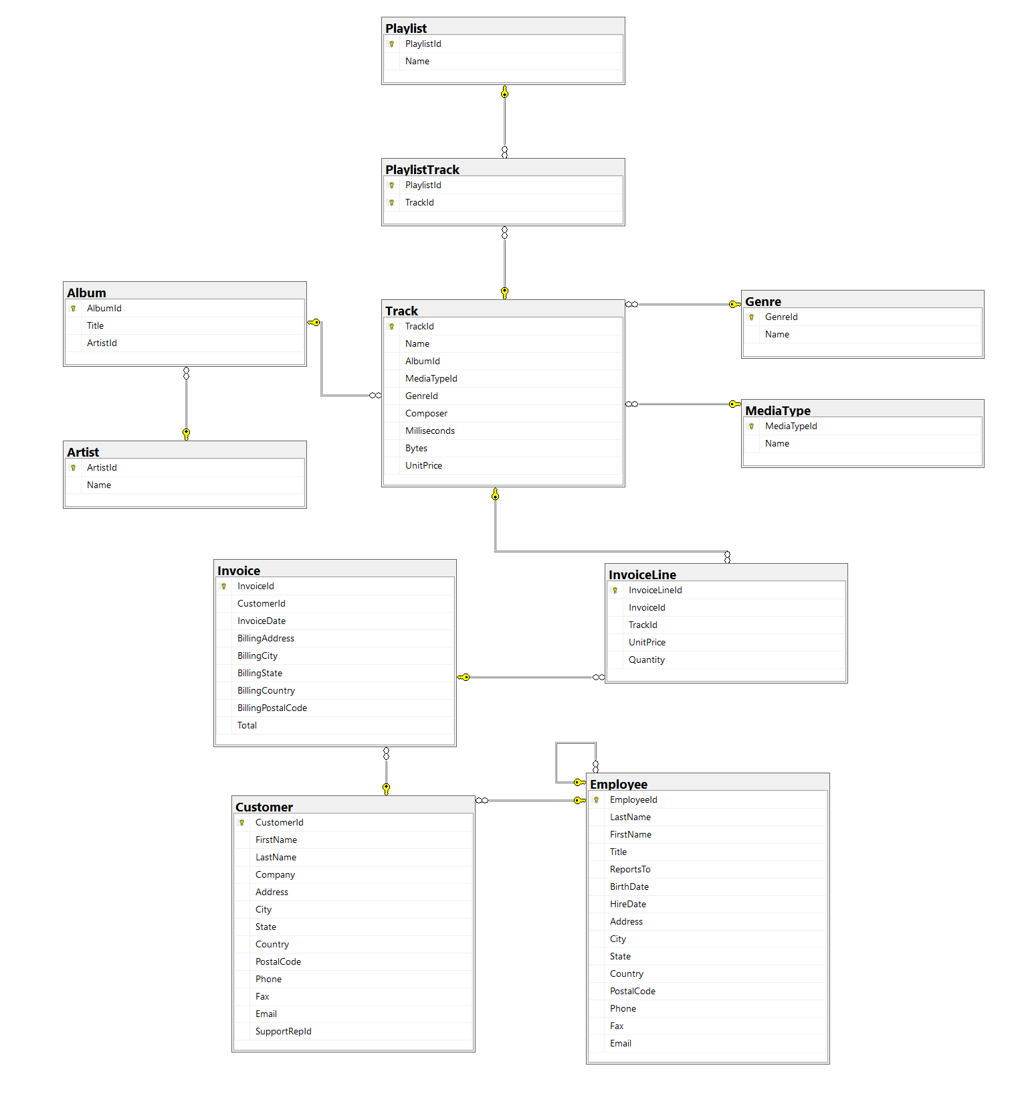
OLTP Database: Chinook
Invoice, InvoiceLine: Tables that contain measures. Used for fact table.
Customer, Employee: Keep as dimensions, exclude some columns
Track: Keep as dimension table. Include information from the tables Album, Artist, Genre, MediaType.
PlaylistTrack: Intermediate table between Playlist and Track tables. Represents a many-to-many relationship.
Playlist: Keep as dimension table.

Slide 4
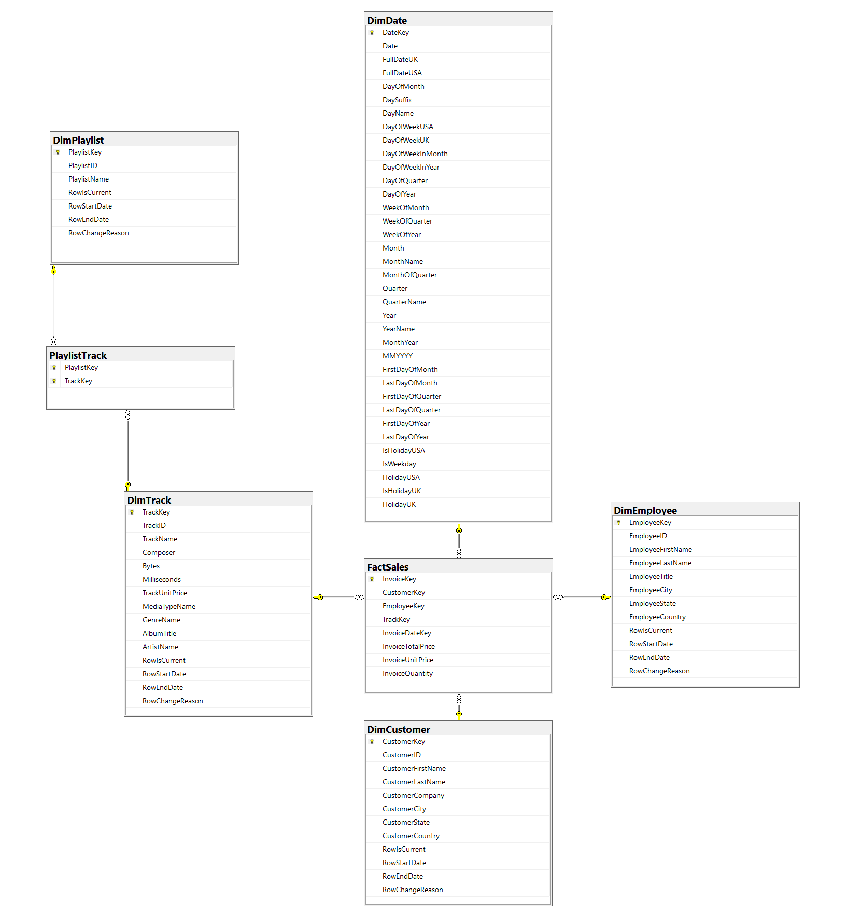
Data Warehouse Snowflake Schema
Fact table:
FactSales
Dimensions:
DimEmployee
DimDate
DimCustomer
DimPlaylist
DimTrack

Slide 5
SCD Type 2 for Customer
Random Changes on Customer table of Chinook database:
Change fields of customer with customerID = 59
Add customer with customerFirstName = Kostas
Notice changes on rows CustomerKey, CustomerId, RowIsCurrent, RowStartDate, RowEndDate, and RowChangeReason.

Slide 6
Delta Loading for FactSales
We added 2 new sales, made by the new customer.
The new sales can be loaded on the FactSales table.

Slide 7
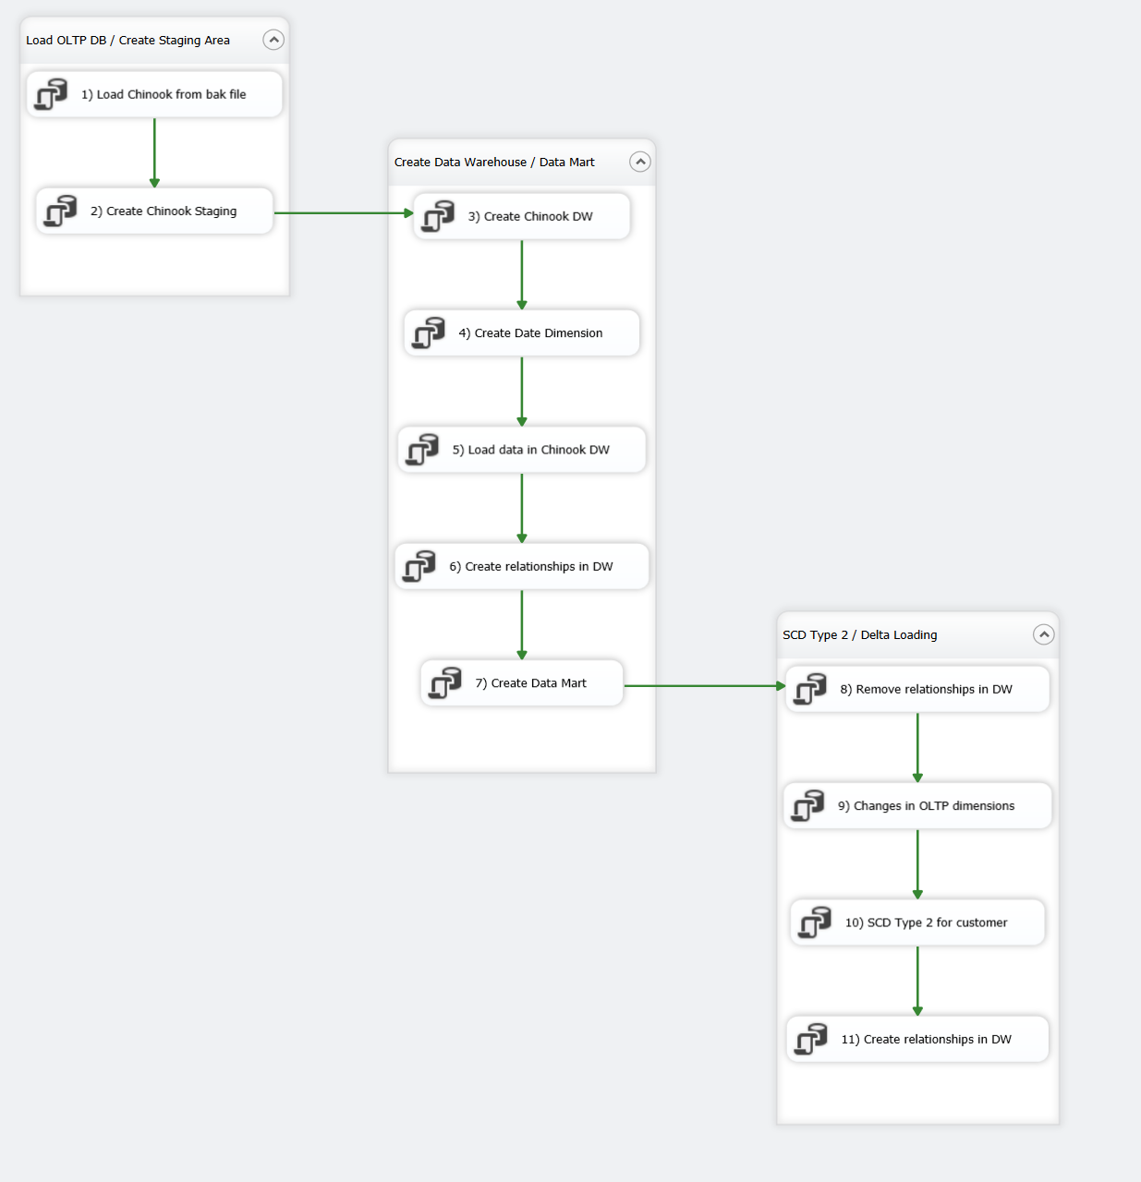
Visual Studio SSIS

Slide 8
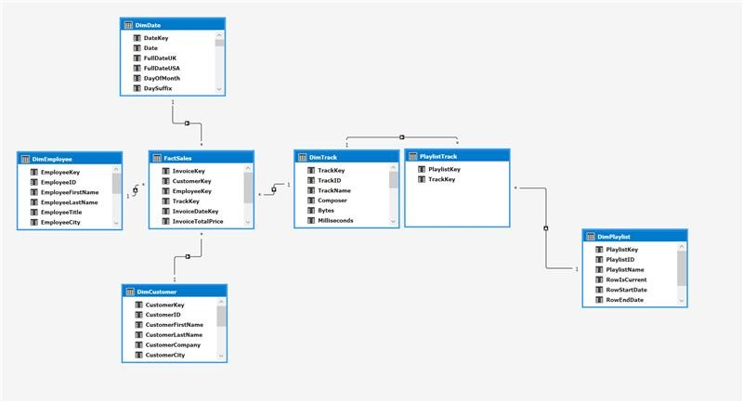
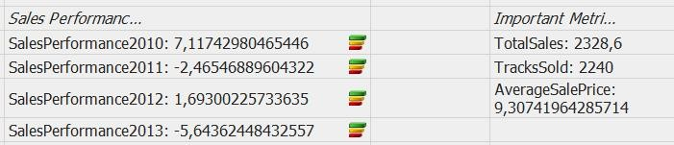
SSAS Tabular Model
Important KPI’S and Metrics

Slide 9
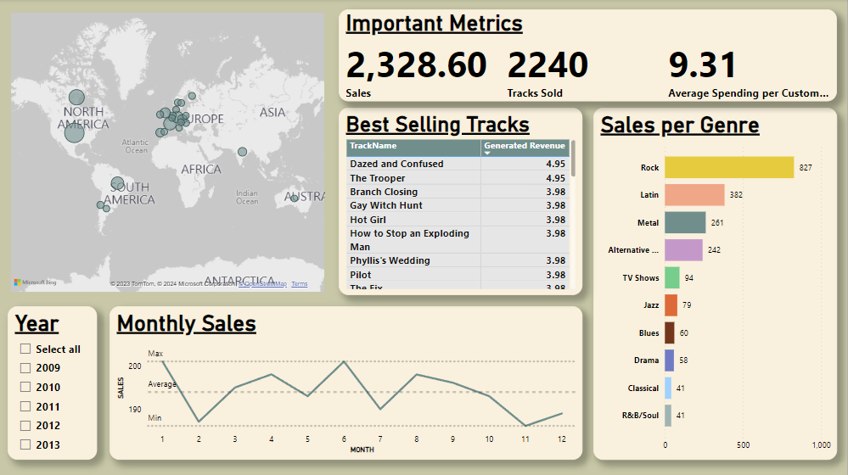
Power BI General Sales Dashboard
Multi-Row Card
Map
Bubble Size: Sales
Track Sales Table
Year Slicer
Stacked Bar Chart
Sales Line Chart

Slide 10
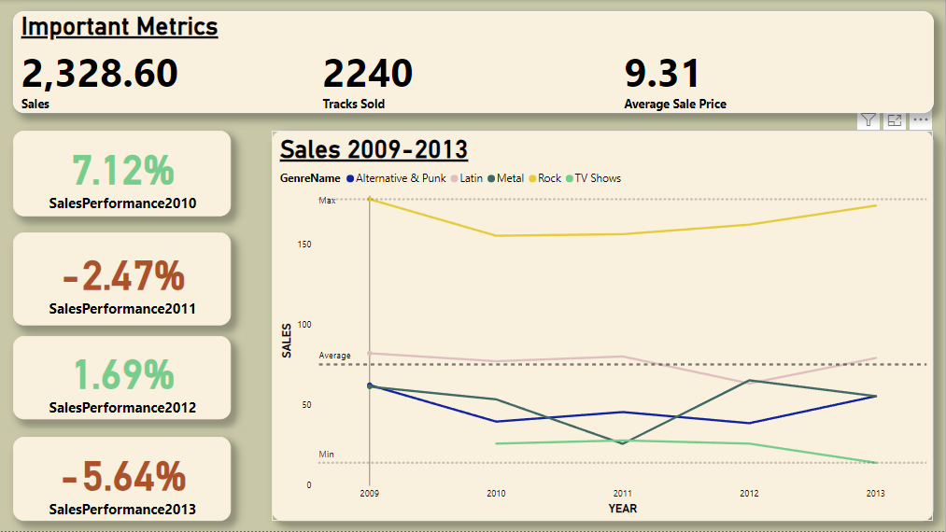
Power BI Genre Long Term Performance Dashboard
ANNUAL SALES PERFORMANCE CARDS
Genre Sales Line Chart
Green: Sales Increase
Red: Sales Decrease

Slide 11
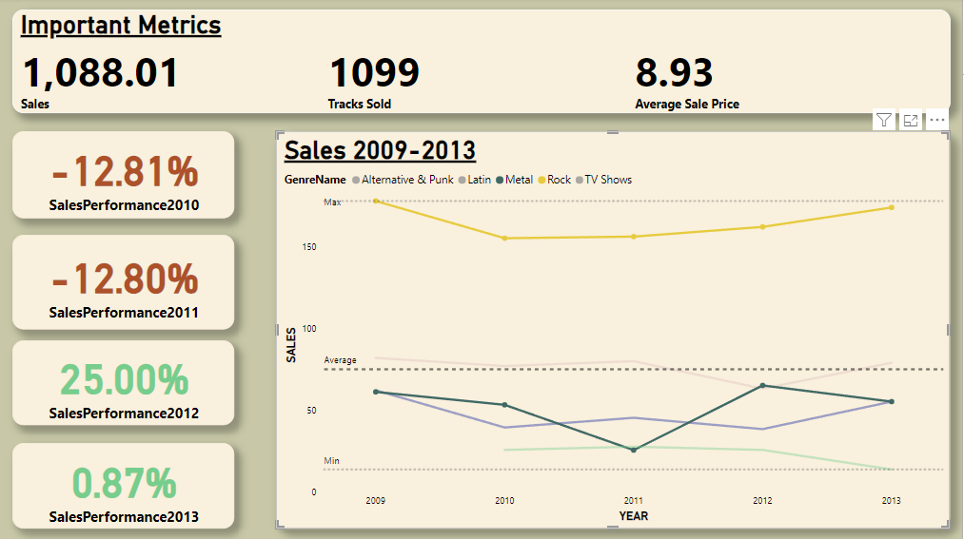
Power BI Genre Long Term Performance Dashboard
The sales progression of Rock and Metal tracks, and their effect on total sales performance

Slide 12
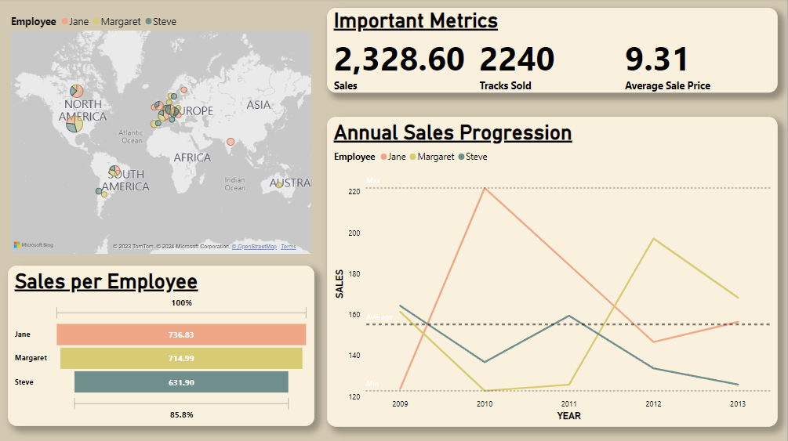
Power BI Employee Long Term Performance
Jane
Margaret
Steve
Funnel Chart

Slide 13
Conclusion
Rock is the best selling genre.
February and November are the worst performing months of the year, making them perfect candidates for promotional offers.
The country with the most sales is USA.
A drop in the sales of Rock & Metal music has an important effect on the total sales in 2011.
Jane is the salesperson with the most sales, but Margaret had the most sales in 2013.
Margaret’s sales are dropping and Janes sales are increasing. We could expect Jane to overcome Margaret in 2014.
Steve’s sales are always bellow average, with an exception in 2011.

Slide 14
Thank you!
QUESTIONS?

